Slide 1
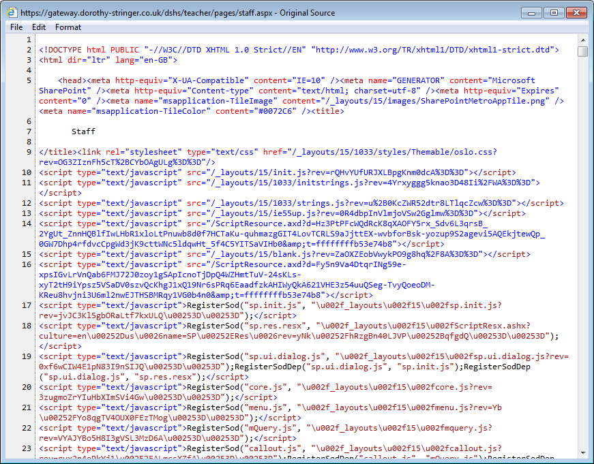
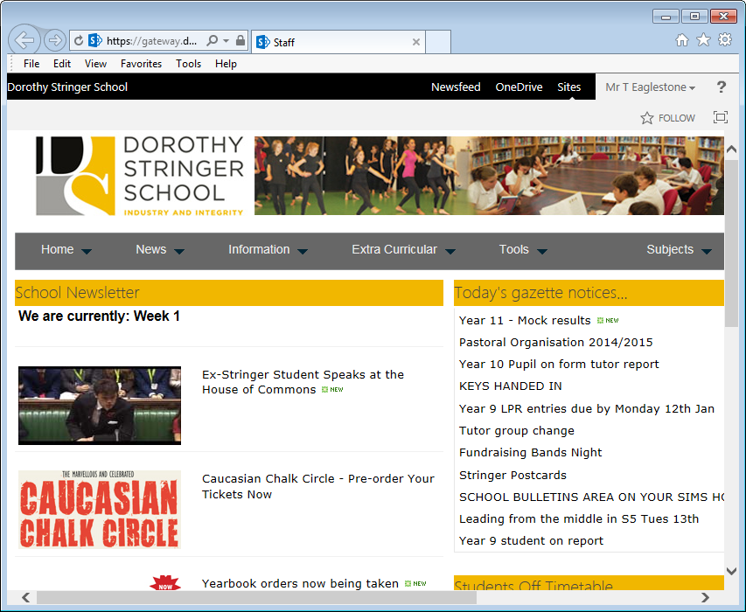
Webpages—starting with HTML

Slide 2
HTML
What you need to know:
HTML is short for HyperText Mark-up Language
It is made up of tags that look like <this>
Tags usually wrap around text like this:
<p>This is a paragraph of writing.</p>

Slide 3
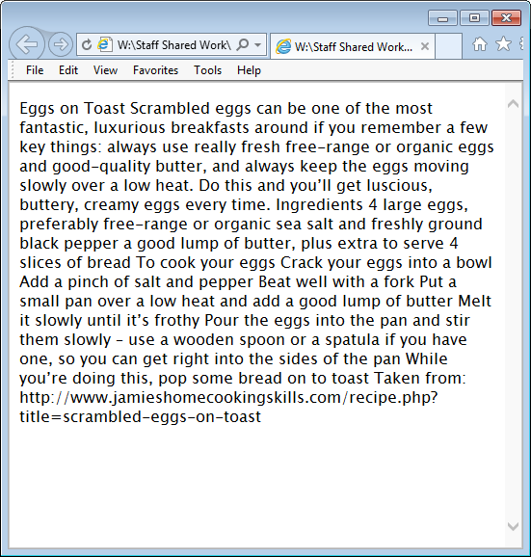
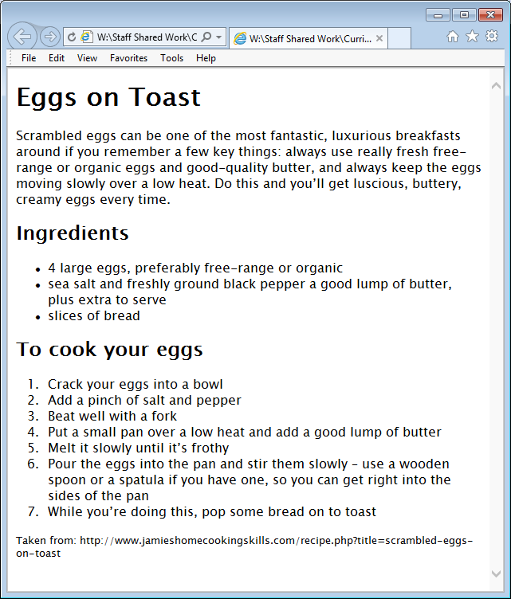
Marking up exercise
Turn this
into this

Slide 4
Download the eggs.txt file from the SLG
Open it in Notepad++
Save As eggs.html
Start to mark it up—use the Hand-out 1 as a guide
Notes:
Demo this to the class

Slide 5
Some basic mark-up
Hand-out 1
Mark-up | What it does
<h1>…</h1> | Sets the text to heading 1 (the biggest heading)
<h2>…</h2> | Sets the text to heading 2 (the second biggest heading)
<p>…</p> | Marks some text as a paragraph
<ul> …</ul> | Stuff in here will be an unordered list
<ol> … </ol> | Stuff in here will be an ordered list (1st, 2nd, 3rd …)
<hr /> | This will draw a line across the page. Note that it does not have a close tag so the / is at the end.

